Slide 2
Test app configuration
Test app has five Pages on a Navigator.
First Page is main page including 4 button.
When each button is clicked, new Page is pushed and shown.
Second Page is red page and it is opened when red button on main page is clicked.
Transition for this page, we can test seamless transition of transform(position, orientation, and scale)

Slide 3
Test app configuration
Third Page is Blue colored page and it is opened when green button on main page is clicked.
Transition for this page, we can test seamless transition of shadow on the inner gray View.
Fourth Page is Cyan colored page and it is opened when blue button on main page is clicked.
Transition for this page, we can test seamless transition of background color.

Slide 4
Test app configuration
The last fifth Page is divided page to show all previous pages and it is opened when grey button on main page is clicked.
Transition for this page, we can test simultaneously played multiple transition and TransitionWithChild property with gray Button and its’ inner white view.
In the second, third, and fourth pages, to click any position on screen pops front page and make return to the main page.
In the last page, right bottom gray button is return button to the main page.

Slide 5



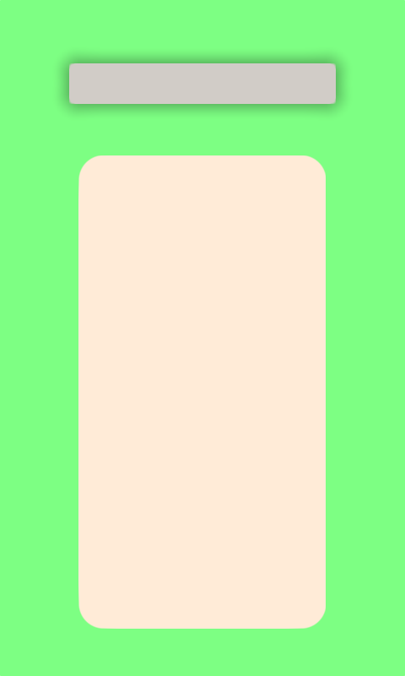
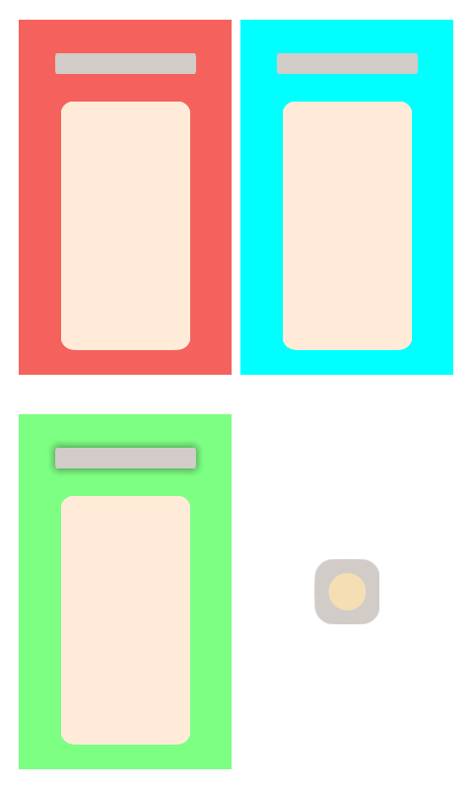
Test app configuration

Slide 6
Test case 1 – Corner radius
For the every transition, corner radius for each View is smoothly animated.

Slide 7
Test case 2 – Transition in Layout
Buttons in main page is in linear layout and the fifth page is made by using grid layout.
During push and pop transition for every pages, check every views are changed with smooth animation without artifacts like flickering

Slide 8
Test case 3 – Transform
Click red button in main page to check transform transition.
Check red circle becomes large full rect(size).
Check red circle becomes large full rect with rotation(orientation)
Check grey rect becomes rect(scale) and is placed upper part and horizontally middle(position).

Slide 9
Test case 4 – shadow
Click green button in main page to check shadow transition.
Check shadow around grey circle becomes that of grey rect after transition.

Slide 10
Test case 5 – Background Color
Click blue button in main page to check background color transition.
Check blue circle becomes Cyan large full rect.

Slide 11
Test case 6 – Transition with Child
Click grey button in main page to check transition with child option.
Grey circle in main page has same transition tag with right bottom grey button in fifth page.
The gray button has true TransitionWithChild property and inner yellow View has no option about transition.
Check inner yellow circle moves following grey circle’s transition.

